Slide 1
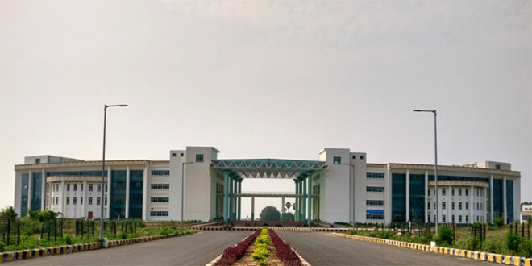

Introduction to Spark
Dr. Rajiv Misra
Dept. of Computer Science & Engg.
Indian Institute of Technology Patna
rajivm@iitp.ac.in
Big Data Computing
Introduction to Spark

Slide 2
Preface
Content of this Lecture:
In this lecture, we will discuss the ‘framework of spark’, Resilient Distributed Datasets (RDDs) and also discuss Spark execution.
Big Data Computing
Introduction to Spark

Slide 3
Need of Spark
Apache Spark is a big data analytics framework that was originally developed at the University of California, Berkeley's AMPLab, in 2012. Since then, it has gained a lot of attraction both in academia and in industry.
It is an another system for big data analytics
Isn’t MapReduce good enough?
Simplifies batch processing on large commodity clusters
Big Data Computing
Introduction to Spark

Slide 4
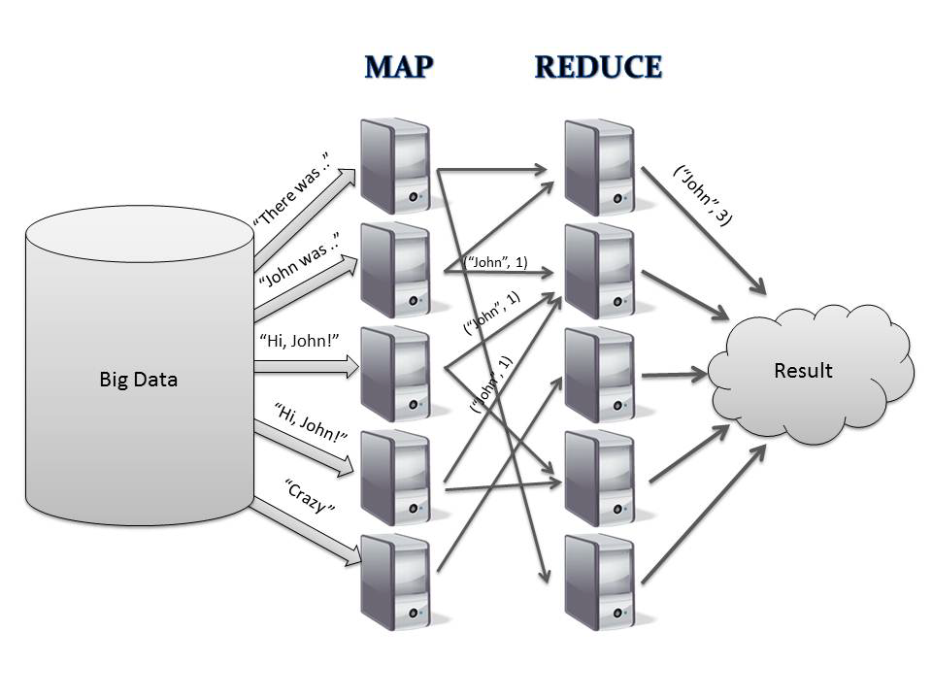
Need of Spark
Map
Reduce
Input
Output
Big Data Computing
Introduction to Spark

Slide 5
Need of Spark
Map
Reduce
Expensive save to disk for fault tolerance
Input
Output
Big Data Computing
Introduction to Spark

Slide 6
Need of Spark
MapReduce can be expensive for some applications e.g.,
Iterative
Interactive
Lacks efficient data sharing
Specialized frameworks did evolve for different programming
models
Bulk Synchronous Processing (Pregel)
Iterative MapReduce (Hadoop) ….
Big Data Computing
Introduction to Spark

Slide 7
Solution: Resilient Distributed Datasets (RDDs)
Resilient Distributed Datasets (RDDs)
Immutable, partitioned collection of records
Built through coarse grained transformations (map, join …)
Can be cached for efficient reuse
Big Data Computing
Introduction to Spark

Slide 8
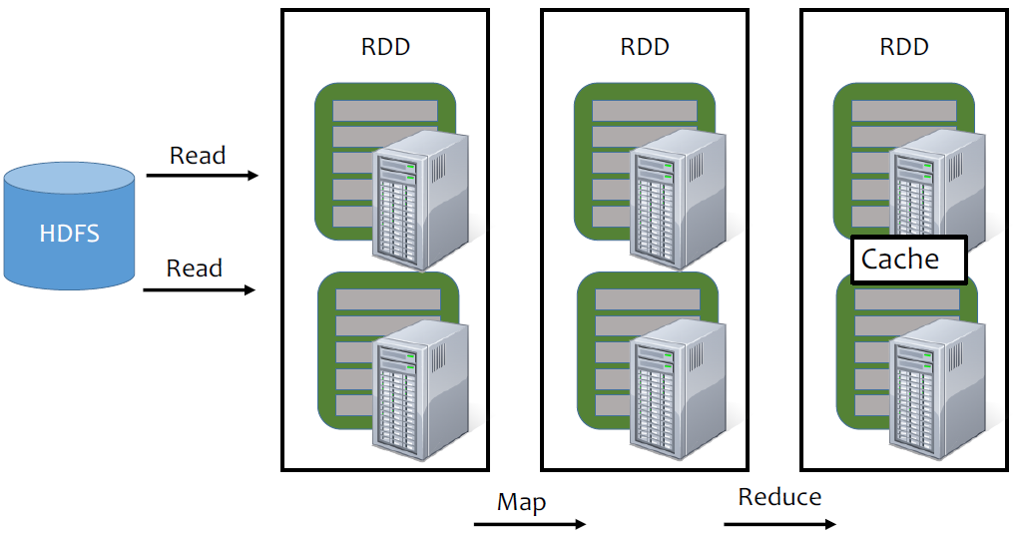
Need of Spark
RDD
RDD
RDD
Read
HDFS
Read
Cache
Map
Reduce
Big Data Computing
Introduction to Spark

Slide 9
Solution: Resilient Distributed Datasets (RDDs)
Resilient Distributed Datasets (RDDs)
Immutable, partitioned collection of records
Built through coarse grained transformations (map, join …)
Fault Recovery?
Lineage!
Log the coarse grained operation applied to a partitioned dataset
Simply recompute the lost partition if failure occurs!
No cost if no failure
Big Data Computing
Introduction to Spark

Slide 10
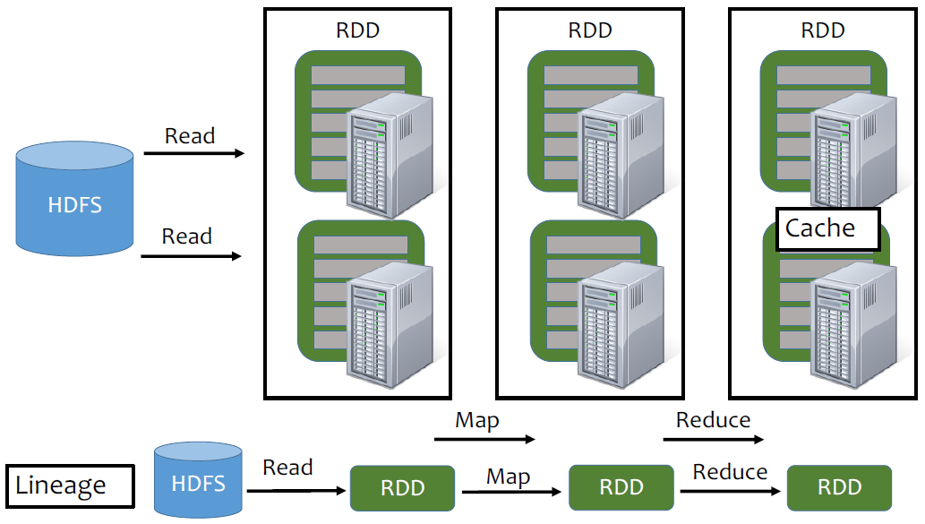
RDD
RDD
RDD
Read
HDFS
Read
Cache
Map
Reduce
Big Data Computing
Introduction to Spark

Slide 11
Read
Map
Reduce
Lineage
HDFS
Introduction to Spark
Big Data Computing
Introduction to Spark

Slide 12
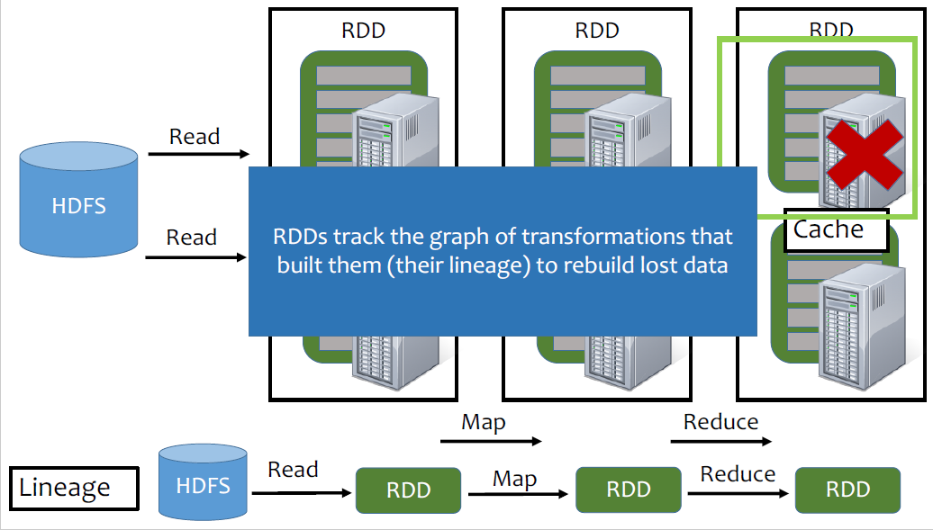
RDD
RDD
RDD
Read
HDFS
RDDs track the graph of transformations that built them (their lineage) to rebuild lost data
Read
Cache
Map
Reduce
Big Data Computing
Introduction to Spark

Slide 13
What can you do with Spark?
RDD operations
Transformations e.g., filter, join, map, group-by …
Actions e.g., count, print …
Control
Partitioning: Spark also gives you control over how you can partition your RDDs.
Persistence: Allows you to choose whether you want to persist RDD onto disk or not.
Big Data Computing
Introduction to Spark

Slide 14
Spark Applications
Twitter spam classification
EM algorithm for traffic prediction
K-means clustering
Alternating Least Squares matrix factorization
In-memory OLAP aggregation on Hive data
SQL on Spark
Big Data Computing
Introduction to Spark

Slide 15

Reading Material
Matei Zaharia, Mosharaf Chowdhury, Michael J. Franklin, Scott Shenker, Ion Stoica
“Spark: Cluster Computing with Working Sets”
Matei Zaharia, Mosharaf Chowdhury et al.
“Resilient Distributed Datasets: A Fault-Tolerant Abstraction for In-Memory Cluster Computing”
https://spark.apache.org/
Big Data Computing
Introduction to Spark

Slide 16
Spark Execution
Big Data Computing
Introduction to Spark

Slide 17
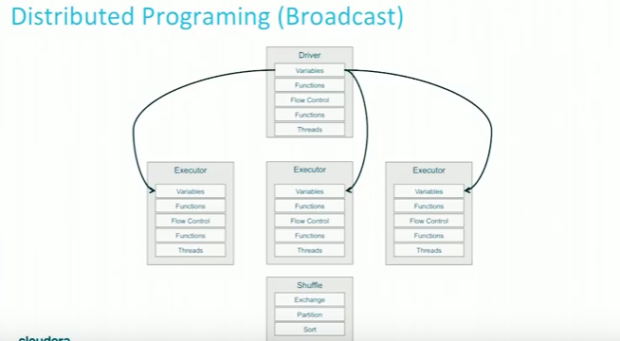
Distributed Programming (Broadcast)
Big Data Computing
Introduction to Spark

Slide 18
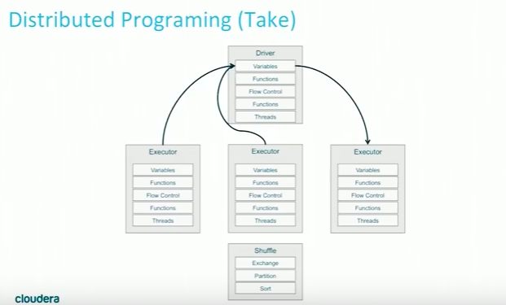
Distributed Programming (Take)
Big Data Computing
Introduction to Spark

Slide 19
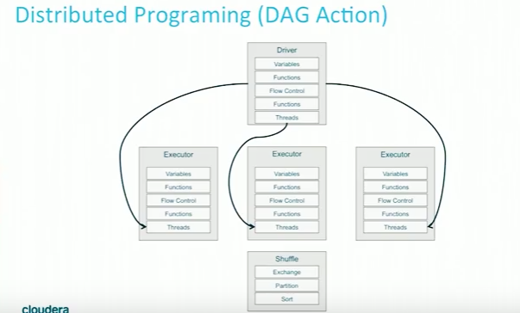
Distributed Programming (DAG Action)
Big Data Computing
Introduction to Spark

Slide 20
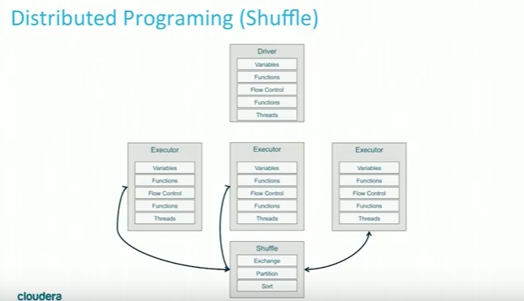
Distributed Programming (Shuffle)
Big Data Computing
Introduction to Spark

Slide 21
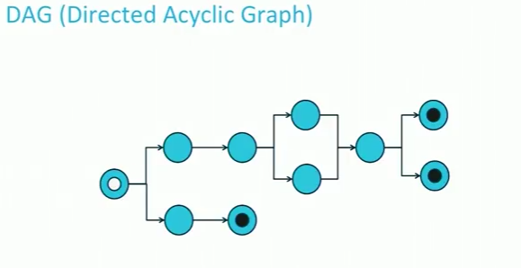
DAG (Directed Acyclic Graph)
Big Data Computing
Introduction to Spark

Slide 22
DAG (Directed Acyclic Graph)
Action
Count
Take
Foreach
Transformation
Map
ReduceByKey
GroupByKey
JoinByKey
Big Data Computing
Introduction to Spark

Slide 23
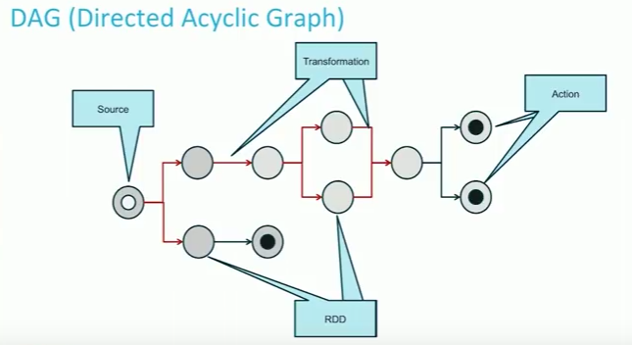
DAG (Directed Acyclic Graph)
Big Data Computing
Introduction to Spark

Slide 24
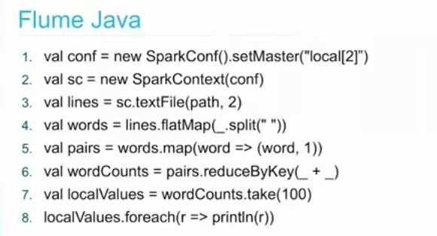
Flume Java
Big Data Computing
Introduction to Spark

Slide 25
Spark Implementation
Big Data Computing
Introduction to Spark

Slide 26
Spark ideas
Expressive computing system, not limited to map-reduce model
Facilitate system memory
avoid saving intermediate results to disk
cache data for repetitive queries (e.g. for machine learning)
Compatible with Hadoop
Big Data Computing
Introduction to Spark

Slide 27
RDD abstraction
Resilient Distributed Datasets
Partitioned collection of records
Spread across the cluster
Read-only
Caching dataset in memory
different storage levels available
fallback to disk possible
Big Data Computing
Introduction to Spark

Slide 28
RDD operations
Transformations to build RDDs through deterministic operations on other RDDs
transformations include map, filter, join
lazy operation
Actions to return value or export data
actions include count, collect, save
triggers execution
Big Data Computing
Introduction to Spark

Slide 29
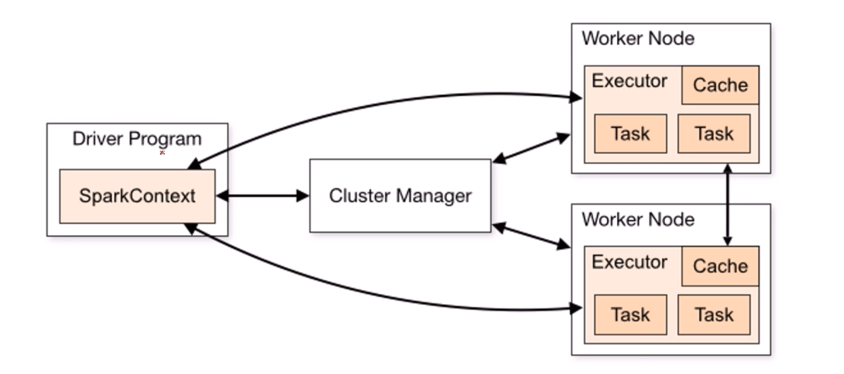
Spark Components
Big Data Computing
Introduction to Spark

Slide 30

Job example
val log = sc.textFile(“hdfs://...”)
val errors = file.filter(_.contains(“ERROR”))
errors.cache()
errors.filter(_.contains(“I/O”)).count()
errors.filter(_.contains(“timeout”)).count()
Driver
Action!
Worker
Worker
Worker
Cache1
Cache2
Cache2
Block1
Block2
Block3
Big Data Computing
Introduction to Spark

Slide 31
RDD partition-level view
Dataset-level view:
Partition-level view:
log:
HadoopRDD path = hdfs://...
errors:
FilteredRDD func = _.contains(…) shouldCache = true
Task 1
Task 2
...
source: https://cwiki.apache.org/confluence/display/SPARK/Spark+Internals
Big Data Computing
Introduction to Spark

Slide 32
Job scheduling
RDD Objects
DAGScheduler
TaskScheduler
Worker
Cluster manager
Threads
DAG
TaskSet
Task
Block manager
rdd1.join(rdd2) .groupBy(…)
.filter(…)
split graph into stages of tasks
launch tasks via cluster manager
execute tasks
submit each stage as ready
retry failed or straggling tasks
store and serve blocks
build operator DAG
source: https://cwiki.apache.org/confluence/display/SPARK/Spark+Internals
Big Data Computing
Introduction to Spark

Slide 33
Available APIs
You can write in Java, Scala or Python
Interactive interpreter: Scala & Python only
Standalone applications: any
Performance: Java & Scala are faster thanks to static typing
Big Data Computing
Introduction to Spark

Slide 34
Hand on - interpreter
script
run scala spark interpreter
or python interpreter
http://cern.ch/kacper/spark.txt
$ spark-shell
$ pyspark
Big Data Computing
Introduction to Spark

Slide 35
Commands walkthrough
val data = sc.textFile("data/geneva.csv") .map(_.split(";")) val tuples = data.filter(rec => (rec.length >= 9)) .mapPartitionsWithIndex{(idx, iter) => if (idx == 0) iter.drop(1) else iter} .map(rec => (rec(0), rec(8))) val dayonly = tuples .filter(rec => (rec._1.substring(12, 14).toInt > 7 && rec._1.substring(12, 14).toInt < 22)) val badweather = dayonly .filter(rec => rec._2 != "\"\"") val distdates = badweather .map(rec => rec._1.substring(1, 11)).distinct() val daysofweek = distdates .map(rec => DateTimeFormat.forPattern("dd.MM.yyyy") .parseLocalDateTime(rec).getDayOfWeek()) val counts = daysofweek.countByValue()
Big Data Computing
Introduction to Spark

Slide 36
Hand on – build and submission
download and unpack source code
build definition in
source code
building
job submission
wget http://cern.ch/kacper/GvaWeather.tar.gz; tar -xzf GvaWeather.tar.gz
GvaWeather/gvaweather.sbt
GvaWeather/src/main/scala/GvaWeather.scala
cd GvaWeather
sbt package
spark-submit --master local --class GvaWeather \
target/scala-2.10/gva-weather_2.10-1.0.jar
Big Data Computing
Introduction to Spark

Slide 37
Summary
Concept not limited to single pass map-reduce
Avoid sorting intermediate results on disk or HDFS
Speedup computations when reusing datasets
Big Data Computing
Introduction to Spark

Slide 38
Conclusion
RDDs (Resilient Distributed Datasets (RDDs) provide a simple and efficient programming model
Generalized to a broad set of applications
Leverages coarse-grained nature of parallel algorithms for failure recovery
Big Data Computing
Introduction to Spark

